Slide 1
COMPILER CONSTRUCTION
Principles and Practice
Kenneth C. Louden

Slide 2
8. Code Generation

Slide 3
8.1 Intermediate Code and Data Structures for Code Generation

Slide 4
8.1.1 Three-Address Code

Slide 5
8.1.2 Data Structures for the Implementation of Three-Address Code

Slide 6
8.1.3 P-Code

Slide 7
8.2 Basic Code Generation Techniques

Slide 8
8.2.1 Intermediate Code or Target Code as a Synthesized Attribute

Slide 9
8.2.2 Practical Code Generation

Slide 10
8.2.3 Generation of Target Code from Intermediate Code

Slide 11
Code generation from intermediate code involves either or both of two standard techniques:
  Macro expansion and Static simulation
Macro expansion involves replacing each kind of intermediate code instruction with an equivalent sequence of target code instructions
Static simulation involves a straight-line simulation of the effects of the intermediate code and generating target code to match these effects

Slide 12
Consider the expression (x=x+3) +4, translate the P-code into three-address code:
Lad x
Lod x
Ldc 3
Adi t1=x+3
Stn x=t1
Ldc 4
Adi t2=t1+4
We perform a static simulation of the P-machine stack to find three-address equivalence for the given code

Slide 13
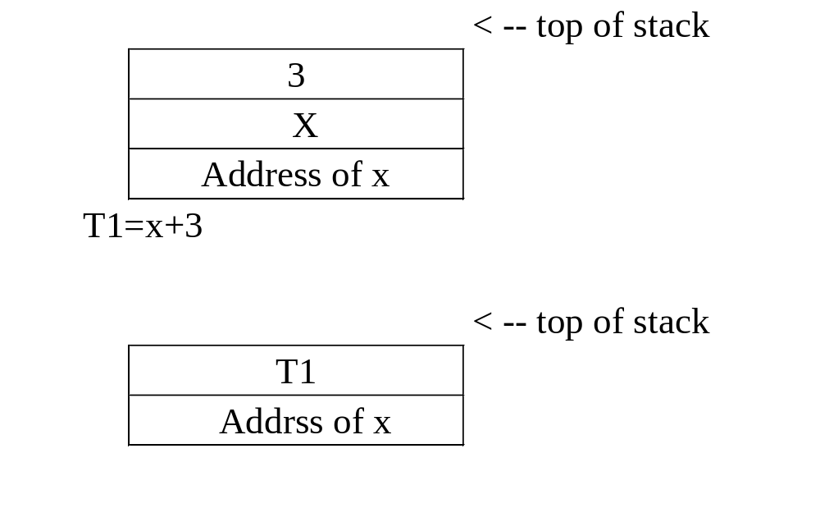

Slide 14
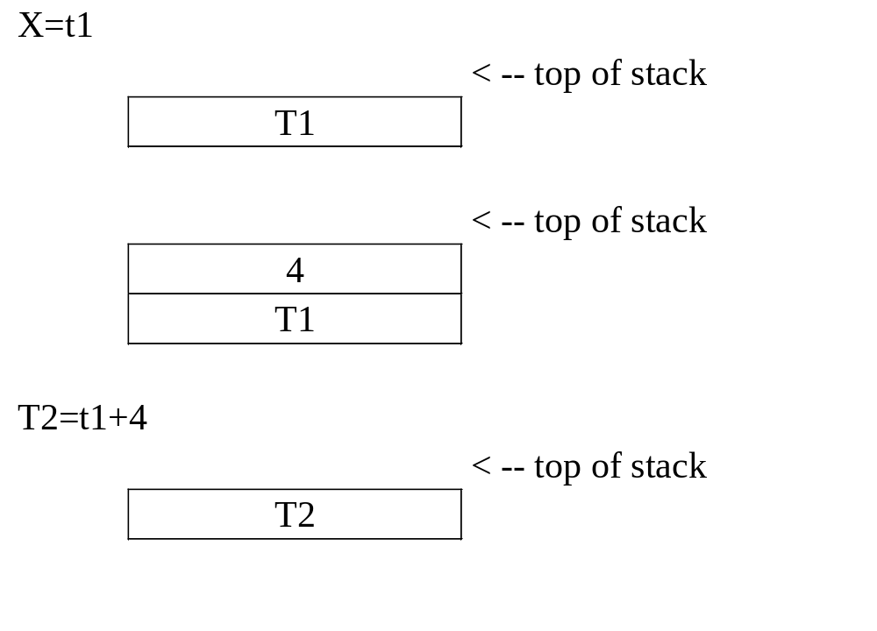

Slide 15
Now consider the case of translating from three-address code to P-code, by simple macro expansion.
A three-address instruction:
a = b + c
Can always be translated into the P-code sequence
lda a
lod b
lod c
adi
sto

Slide 16
Then, the three-address code for the expression (x=x+3)+4:
T1 = x + 3
X = t1
T2 = t1 + 4
Can be translated into the following P-code:
Lda t1
Lod x
Ldc 3
Adi
Sto
Lad x
Lod t1
Sto
Lda t2
Lod t1
Ldc 4
Adi
Sto

Slide 17
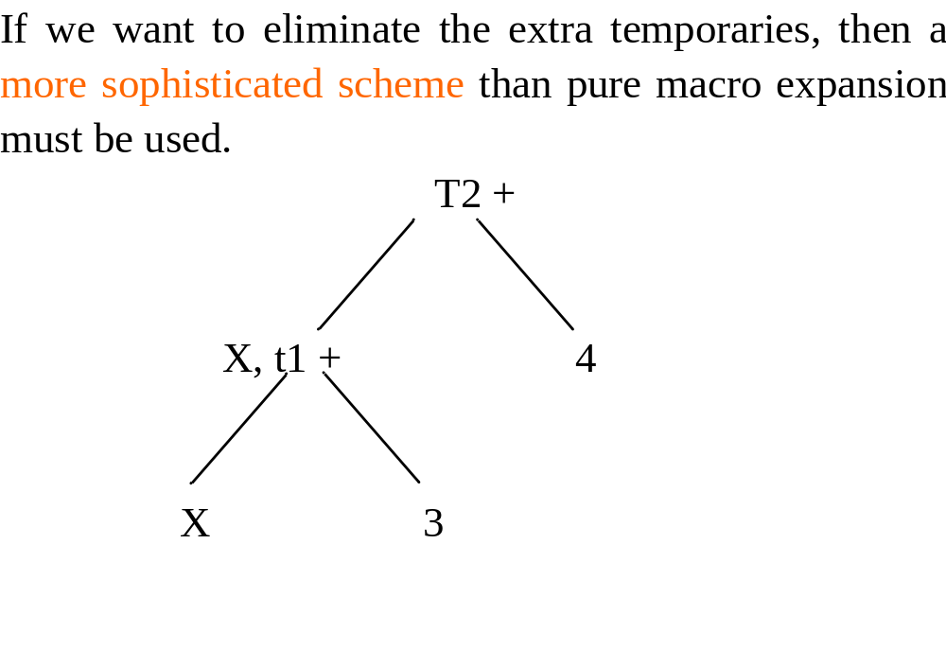

Slide 18
Contents
Part One
8.1 Intermediate Code and Data Structure for code Generation
8.2 Basic Code Generation Techniques
Part Two
8.3 Code Generation of Data Structure Reference
8.4 Code Generation of Control Statements and Logical Expression
8.5 Code Generation of Procedure and Function calls
Other Parts
8.6 Code Generation on Commercial Compilers: Two Case Studies
8.7 TM: A Simple Target Machine
8.8 A Code Generator for the TINY Language
8.9 A Survey of Code Optimization Techniques
8.10 Simple Optimizations for TINY Code Generator

Slide 19
8.3 Code Generation of Data Structure References

Slide 20
8.3.1 Address Calculations

Slide 21
(1) Three-Address Code for Address Calculations
The usual arithmetic operations can be used to compute addresses
Suppose wished to store the constant value 2 at the address of the variable x plus 10 bytes
  t1 = &x +10
  *t1 = 2
The implementation of these new addressing modes requires that the data structure for three-address code contain a new field or fields
  For example, the quadruple data structure of Figure 8.4 (page 403) can be augmented by an enumerated address-mode field with possible values none, address, and indirect

Slide 22
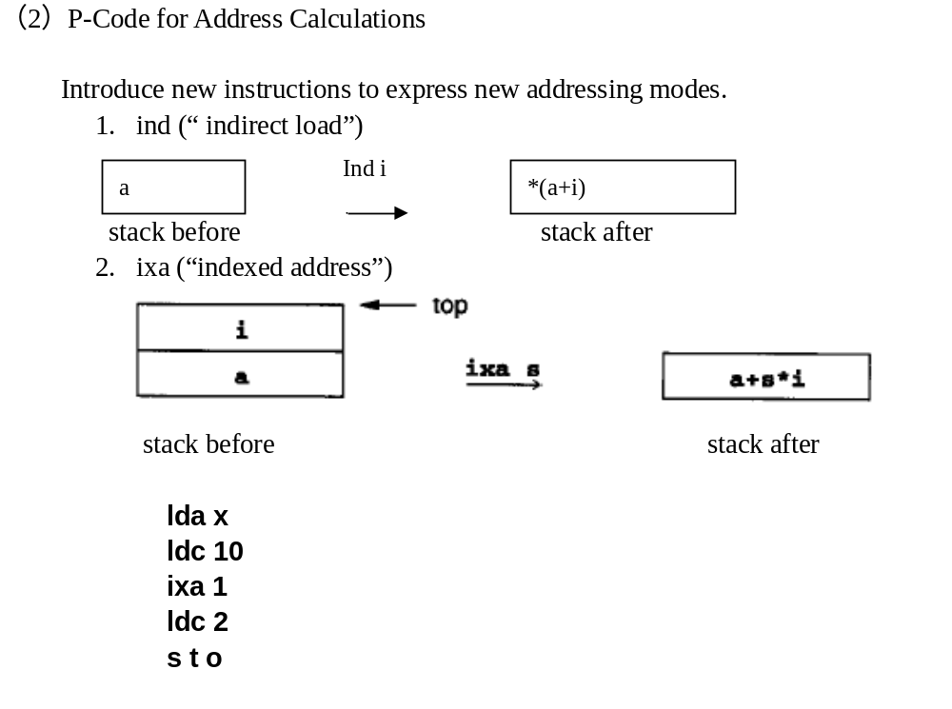

Slide 23
8.3.2 Array References

Slide 24
The offset is computed from the subscript value as follows:
  First, an adjustment must be made to the subscript value if the subscript range does not begin at 0
  Second, the adjusted subscript value must be multiplied by a scale factor that is equal to the size of each array element in memory
  Finally, the resulting scaled subscript is added to the base address to get the final address of the array element.
The address of an array element a[t] :
  b a s e _ a d d ress (a) + (t - lower_bound (a)) * element_size (a)

Slide 25
(1) Three-Address Code for Array References
Introduce two new operations：
One that fetches the value of an array element
  t2= a[t1]
And one that assigns to the address of an array element
  a[t2]= t1
For an example:
  a[i+1] = a [j*2]+3
Translate into the three-address instructions
( with the symbols: =[], []=)
  t1 = j * 2
  t2 = a [t1]
  t3 = t2 + 3
  t4 = i + 1
  a [t4] = t3

Slide 26
Writing out the addresses computations of an array element directly in the code,
The above example can be finally translated into:
    t1 = j * 2
    t2 = t1 * elem_size(a)
    t3 = &a + t2
    t4 = *t3
    t5 = t4 + 3
    t6 = i + 1
    t7 = t6 * elem_size (a)
    t8 = &a + t7
    *t8 = t5

Slide 27
(2) P-Code for Array References
Use the new address instructions ind and ixa. The above example
  a[i+1] = a [j*2]+3
Will finally become:
  lda a
  lod i
  ldc 1
  a d i
  ixa elem_size(a)
  lda a
  lod j
  ldc 2
  m p i
  ixa elem_size(a)
  ind 0
  ldc 3
  a d I
  sto

Slide 28
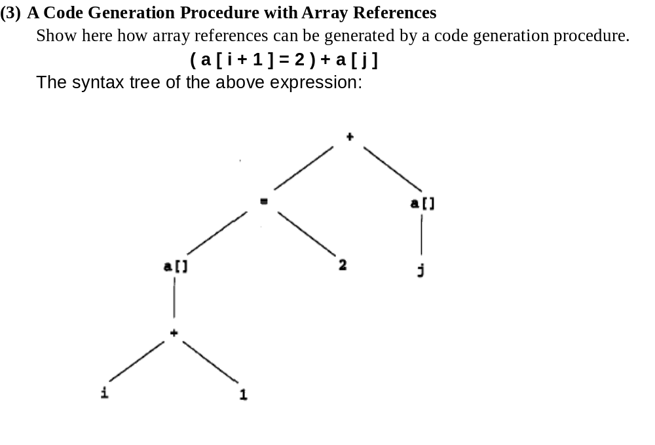

Slide 29
Array reference generated by a code generation procedure.
( a [ i + 1 ] = 2 ) + a [ j ]
  lda a
  lod i
  ldc 1
  a d i
  ixa elem_size(a)
  ldc 2
  s t n
  lda a
  lod j
  ixa elem_size(a)
  ind 0
  adi

Slide 30
The code generation procedure for p-code:
Void gencode( syntaxtree t, int isaddr)
{char codestr[CODESIZE];
/*CODESIZE = max length of 1 line of p-code */
if (t != NULL)
{ switch(t->kind)
{ case OpKind:
switch (t->op)
{ case Plus:
if (is Addr) emitcode(“Error”);
else { genCode(t->lchild, FALSE);
genCode(t->rchild, FALSE);
emitcode(“adi”);}
break;

Slide 31
case Assign:
genCode(t->lchild, TRUE);
genCode(t->rchild, FALSE);
emitcode(“stn”);}
break;
case Subs:
sprintf(codestr,”%s %s”,”lda”, t->strval);
emitcode(codestr);
gencode(t->lchild,FALSE);
sprintf(codestr,”%s%s%s”,
“ixa elem_size(“,t->strval,”)”);
emitcode(codestr);
if (!isAddr) emitcode (“ind 0”);
break;

Slide 32
default:
emitcode(“Error”);
break;
}
break;
case ConstKind:
if (isAddr) emitcode(“Error”);
else
{ sprintf(codestr,”%s %s”,
”ldc”,t->strval);
emitCode(codestr);
}
break;

Slide 33
case IdKind:
if (isAddr)
sprintf(codestr,”%s %s”,”lda”,t->strval);
else
sprintf(codestr,”%s %s”,”lod”,t->strval);
emitcode(codestr);
break;
default:
emitCode(“Error”);
break;
}
}
}

Slide 34
(4) Multidimensional Arrays
For an example, in C an array of two dimensions can be declared as:
Int a[15][10]
Partially subscripted, yielding an array of fewer dimensions:
a[i]
Fully subscripted, yielding a value of the element type of the array:
a[i][j]
The address computation can be implemented by recursively applying the above techniques

Slide 35
8.3.3 Record Structure and Pointer References

Slide 36
Computing the address of a record or structure field presents a similar problem to that of computing a subscripted array address
  First, the base address of the structure variable is computed;
  Then, the (usually fixed) offset of the named field is found,
  and the two are added to get the resulting address
For example, the C declarations:
  Typedef struct rec
  { int i;
  char c;
  int j;
  } Rec;
  …
  Rec x;

Slide 37
(Other memory)
x.j
x.c
x.i
(Other memory)
Offset of x.j
Memory
allocated
to x
Offset of x.c
Base address of x

Slide 38
1) Three-Address Code for Structure and Pointer References
Use the three-address instruction
  t1 = &x + field_offset (x,j)
x.j = x.i;
be translated into
  t1 = &x + field_offset (x,j)
  t2 = &x + field_offset (x,i)
  *t1 = *t2
Consider the following example of a tree data structure and variable declaration in C:
  typedef struct treeNode
  { int val;
  struct treeNode * lchild, * rchild;
  } TreeNode;

Slide 39
  typedef struct treeNode
  { int val;
  struct treeNode * lchild, * rchild;
  } TreeNode;
. . .
TreeNode *p;
p -> lchild = p;
p = p -> rchild;
translate into the three-address code
  t1 = p + field_offset ( *p, lchild )
  *t1 = p
  t2 = p + field_offset ( *p, rchild )
  p = *t2

Slide 40
2) P-Code for Structure and Pointer References
x.j = x.i
translated into the P-code
  lda x
  lod field_offset (x,j)
  ixa 1
  lda x
  ind field_offset (x,i)
  sto

Slide 41
The assignments:
p->lchild = p;
p = p->rchild
Can be translated into the following P-code.
Lod p
Lod field-offset(*p,lchild)
Ixa 1
Lod p
Sto
Lda p
Lod p
Ind field_offset(*p,rchild)
sto

Slide 42
8.4 Code Generation of Control Statements and Logical Expressions

Slide 43
The section will describe code generation for various forms of control statements.
  Chief among these are the structured if-statement and while-statement
Intermediate code generation for control statements involves the generation of labels in manner,
  Which stand for addresses in the target code to which jumps are made
If labels are to be eliminated in the generation of target code,
  The a problem arises in that jumps to code locations that are not yet known must be back-patched, or retroactively rewritten.

Slide 44
8.4.1 Code Generation for If – and While – Statements

Slide 45
Two forms of the if- and while-statements:
  if-stmt → i f ( e x p ) stmt | i f ( exp ) stmt e l s e stmt
  while-stmt → w h i l e ( e x p ) s t m t
The chief problem is to translate the structured control features into an “unstructured” equivalent involving jumps
  Which can be directly implemented.
Compilers arrange to generate code for such statements in a standard order that allows the efficient use of a subset of the possible jumps that target architecture might permit.

Slide 46
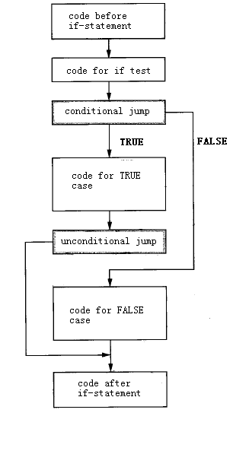
The typical code arrangement for an if-statement is shown as follows:

Slide 47
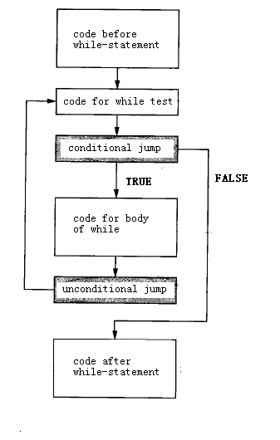
While the typical code arrangement for a while-statement

Slide 48
Three-Address Code for Control Statement
For the statement:
  if ( E ) S1 e l s e S2
The following code pattern is generated:
  <code to evaluate E to t1>
  if_false t1 goto L1
  <code for S1>
  goto L2
  label L1
  <code for S 2>
  label L2

Slide 49
Three-Address Code for Control Statement
Similarly, a while-statement of the form
while ( E ) S
Would cause the following three-address code pattern to be generated:
    label L1
    <code to evaluate E to t1>
    if_false t1 goto L2
    <code for S>
    goto L1
    label L2

Slide 50
P-Code for Control Statement
For the statement
  if ( E ) S1 else S 2
The following P-code pattern is generated:
  <code to evaluate E>
  fjp L1
  <code for S 1>
  ujp L2
  lab L1
  <code for S 2>
  lab L2

Slide 51
P-Code for Control Statement
And for the statement
  while ( E ) S
The following P-code pattern is generated:
  lab L1
  <code to evaluate E>
  fjp L2
  <code for S>
  ujp L1
  lab L2

Slide 52
8.4.2 Generation of Labels and Back-patching

Slide 53
One feature of code generation for control statements that can cause problems during target code generation is the fact that, in some cases, jumps to a label must be generated prior to the definition of the label itself
A standard method for generating such forward jumps is either to leave a gap in the code where the jump is to occur or to generate a dummy jump instruction to a fake location
Then, when the actual jump location becomes known, this location is used to fix up, or back-patch, the missing code

Slide 54
During the back-patching process a further problem may arise in that many architectures have two varieties of jumps, a short jump or branch ( within 128 bytes if code) and a long jump that requires more code space
In that case, a code generator may need to insert nop instructions when shortening jumps, or make several passes to condense the code

Slide 55
8.4.3 Code Generation of Logical Expressions

Slide 56
The standard way to do this is to represent the Boolean value false as 0 and true as 1.
  Then standard bitwise and and or operators can be used to compute the value of a Boolean expression on most architectures
A further use of jumps is necessary if the logical operations are short circuit. For instance, it is common to write in C:
  if ((p!=NULL) && ( p->val==0) ) ...
  Where evaluation of p->val when p is null could cause a memory fault
Short-circuit Boolean operators are similar to if-statements, except that they return values, and often they are defined using if-expressions as
  a and b :: if a then b else false
  and
  a or b :: if a then true else b

Slide 57
To generate code that ensures that the second sub-expression will be evaluated only when necessary
  Use jumps in exactly the same way as in the code for if-statements
For instance, short-circuit P-code for the C expression ( x ! = 0 ) & & ( y = = x ) is:
    lod x
    ldc 0
    n e q
    fjp L1
    lod y
    lod x
    e q u
    ujp L2
    lab L1
    lod FALSE
    lab L2

Slide 58
8.4.4 A Sample code Generation Procedure for If- and While- Statements

Slide 59
Exhibiting a code generation procedure for control statements using the following simplified grammar:
    stmt → if-stmt | while-stmt | b r e a k | o t h e r
    if-stmt → i f ( exp ) stmt | i f ( e x p ) stmt e l s e s t m t
    while-stmt → w h i l e ( e x p ) s t m t
    exp → t r u e | f a l s e

Slide 60
The following C declaration can be used to implement an abstract syntax tree for this grammar:
  typedef enum { ExpKind, IfKind,
  WhileKind, BreakKind, OtherKind } NodeKind;
  typedef struct streenode
  { NodeKind kind;
  struct streenode * child[3] ;
  int val; /* used with ExpKind */
  } STreeNode;
  typedef STreeNode * SyntaxTree;

Slide 61
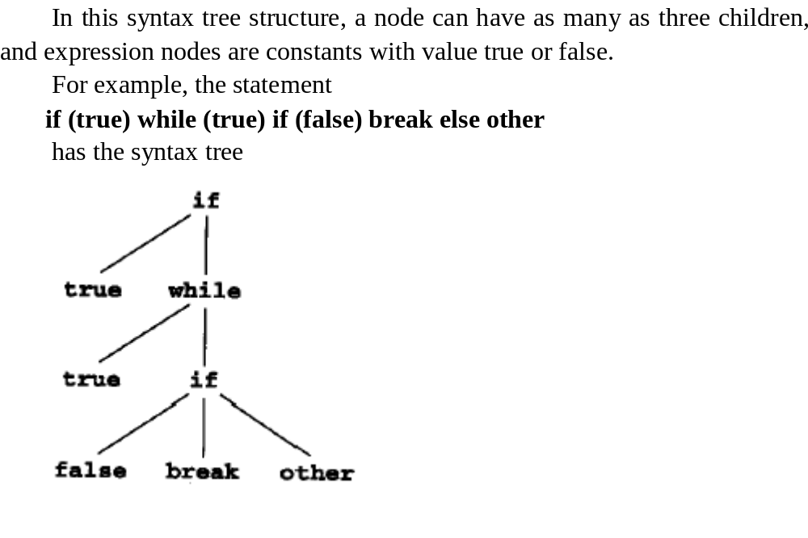

Slide 62
Using the given typedef’s and the corresponding syntax tree structure, a code generation procedure that generates P-code is given as follows:
Void genCode(SyntaxTree t, char* lable)
{ char codestr[CODESIZES];
char *lab1, *lab2;
if (t!=NULL) switch (t->kind)
{case ExpKind:
if (t->val==0) emitCode(“ldc false”);
else emitcode(“ldc true”);
break;

Slide 63
case IfKind:
genCode(t->child[0], label);
lab1 = genLable();
sprintf(codestr,”%s %s”, “fjp”,lab1);
emitcode(codestr);
gencode(t->child[1],label);
if (t->child[2]!=NULL)
{ lab2=genlable();
sprintf(codestr,”%s %s”,”ujp”,lab2);
emitcode(codestr);}
sprintf(codestr,”%s %s”,”lab”,lab1);
emitcode(codestr);
if (t->child[2]!=NULL)
{ gencode(t->child[2],lable);
sprintf(codestr,”%s %s”,”lab”,lab2);
emitcode(codestr);}
break;

Slide 64
case WhileKind;
lab1=genlab();
sprintf(codestr,”%s %s”, “lab”,lab1);
emitcode(codestr);
gencode(t->child[0],label);
lab2=genlabel();
sprintf(codestr,”%s %s”, “fjp”,lab2);
emitcode(codestr);
gencode(t->child[1],lab2);
sprintf(codestr,”%s %s”, “ujp”,lab1);
emitcode(codestr);
sprintf(codestr,”%s %s”, “lab”,lab2);
emitcode(codestr);
break;

Slide 65
case BreakKind:
sprintf(codestr,”%s %s”, “ujp”,label);
emitcode(codestr);
break;
case OtherKind:
emitcode(“other”);
break;
Default:
emitcode(“other”);
break;
}
}

Slide 66
For the statement,
  if (true) while (true) if (false) break else other
The above procedure generates the code sequence
    ldc true
    fjp L1
    lab L2
    ldc true
    fjp L3
    ldc false
    fjp L4
    ujp L3
    ujp L5
    lab L4
    Other
    lab L5
    ujp L2
    lab L3
    Lab L1

Slide 67
8.5 Code Generation of Procedure and Function Calls

Slide 68
8.5.1 Intermediate Code for Procedures and Functions

Slide 69
The requirements for intermediate code representations of function calls may be described in general terms as follows
First, there are actually two mechanisms that need descriptions:
  function/procedure definition
  and function/procedure call
A definition creates a function name, parameters, and code, but the function does not execute at that point
A call creates values for the parameters and performs a jump to the code of the function, which then executes and returns

Slide 70
Intermediate code for a definition must include
  An instruction marking the beginning, or entry point, of the code for the function,
  And an instruction marking the ending, or return point, of the function
    Entry instruction
    <Code for the function body>
    Return instruction
Similarly, a function call must have an instruction
  indicating the beginning of the computation of the arguments and an actual call instruction that indicates the point where the arguments have been constructed
  and the actual jump to the code of the function can take place
    Begin-argument-computation instruction
    <Code to compute the arguments >
    Call instruction

Slide 71
Three-Address Code for Procedures and Functions
In three-address code, the entry instruction needs to give a name to the procedure entry point, similar to the label instruction; thus, it is a one-address instruction, which we will call simply entry. Similarly, we will call the return instruction return
For example, consider the C function definition.
  int f ( int x, int y )
  { return x + y + 1; }
This will translate into the following three-address code:
  entry f
  t1 = x + y
  t2 = t1 + 1
  return t2

Slide 72
Three-Address Code for Procedures and Functions
For example, suppose the function f has been defined in C as in the previous example.
Then, the call
  f ( 2+3, 4)
Translates to the three-address code
  begin_args
  t1 = 2 + 3
  arg t1
  arg 4
  call f

Slide 73
P-code for Procedures and functions
The entry instruction in P-code is ent, and the return instruction is ret
  int f ( int x, int y )
  { return x + y + 1; }
Thus the definition of the C function f translates into the P-code
  ent f
  lod x
  lod y
  a d i
  ldc 1
  a d i
  r e t

Slide 74
P-code for Procedures and functions
Our example of a call in C (the call f (2+3, 4) to the function f described previously) now translates into the following P-code:
    m s t
    ldc 2
    ldc 3
    a d i
    ldc 4
    cup f

Slide 75
8.5.2 A Code Generation Procedure for Function Definition and Call

Slide 76
The grammar we will use is the following:
    program → decl-list exp
    decl-list → decl-list decl | ε
    decl → f n id ( param-list ) = e x p
    param-list → p a ram - list, id | id
    exp → exp + exp | call | num | id
    call → id ( arg-list )
    arg-list → a rg-list, exp | exp
An example of a program as defined by this grammar is
    fn f(x)=2+x
    fn g(x,y)=f(x)+y
    g ( 3 , 4 )

Slide 77
We do so using the following C declarations:
  typedef enum
    {PrgK, FnK, ParamK, PlusK, CallK, ConstK, IdK}
    NodeKind ;
  typedef struct streenode
    { NodeKind kind;
    struct streenode *lchild,*rchild, * s i b l i n g ;
    char * name; /* used with FnK,ParamK,Callk,IdK */
    int val; /* used with ConstK */
    } StreeNode;
  typedef StreeNode * SyntaxTree;

Slide 78
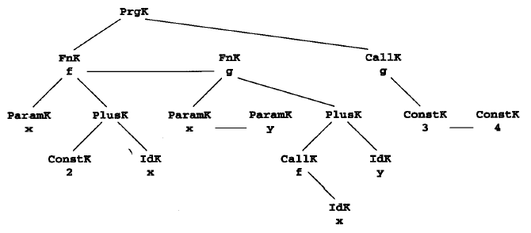
Abstract syntax tree for the sample program :
    fn f(x)=2+x
    fn g(x,y)=f(x)+y
    g ( 3 , 4 )

Slide 79
Given this syntax tree structure, a code generation procedure that produces P-code is given in the following:
Void genCode( syntaxtree t)
{ char codestr[CODESIZE];
SyntaxTree p;
If (t!=NULL)
Switch (t->kind)
{ case PrgK:
p = t->lchild;
while (p!=NULL)
{ gencode(p);
p = p->slibing;}
gencode(t->rchild);
break;

Slide 80
case FnK:
sprintf(codestr,”%s %s”,”ent”,t->name);
emitcode(codestr);
gencode(t->rchild);
emitcode(“ret”);
break;
case ConstK:
sprintf(codestr,”%s %d”,”ldc”,t->val);
emitcode(codestr);
break;
case PlusK:
gencode(t->lchild);
gencode(t->rchild);
emitcode(“adi”);
break;
case IdK:
sprintf(codestr,”%s %s”,”lod”,t->name);
emitcode(codestr);
break;

Slide 81
case CallK:
emitCode(“mst”);
p = t->rchild;
while (p!=NULL)
{genCode(p);
p = p->sibling;}
sprintf(codestr,”%s %s”,”cup”,t->name);
emitcode(codestr);
break;
default:
emitcode(“Error”);
break;
}
}

Slide 82
Given the syntax tree in Figure 8.13, the generated the code sequences:
    Ent f
    Ldc 2
    Lod x
    Adi
    Ret
    Ent g
    Mst
    Lod x
    Cup f
    Lod y
    Adi
    Ret
    Mst
    Ldc 3
    Ldc 4
    Cup g

Slide 83
End of Part Two
THANKS

